Slide 1
An algorithm for the multiple patterns approximate string matching problem
Chia-Wei Lu, Chun-Yuan Lin, Chuan-Yi Tang, Wing-Kai Hon
The 26th Workshop on Combinatorial Mathematics and Computation Theory
Presenter : Chih-Ying Lin
Date : June 09, 2009

Slide 2
Abstract
We propose an algorithm to solve the multiple patterns approximate string matching problem. Our algorithm uses a hashing table to quickly find all possible positions. Our algorithm is very efficient for multiple patterns with different lengths. We also implemented our algorithm to solve the short oligonucleotide(寡核酸) alignment on a long reference DNA sequence problem. The experimental results show that our algorithm is faster than one of the fastest algorithm available now, SOAP.

Slide 3
Lemma
Let P = P₁X₁P₂X₂….P_{j}X_{j} for any j ≥ 1, where P_{i} and X_{i} are substrings of P . Suppose there is a substring S of T whose edit distance from P is smaller than or equal to k. Then at least one P_{i} appears in with at most ⎣k/j⎦ errors.

Slide 4
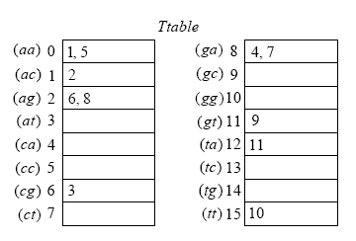
Preprocessing
K = 2
T = a a c g a a g a g t t a
P = a c a g t c
Σ = {a, c, g, t} , we use 00, 01, 10 ,11 to substitute a , c , g , t

Slide 5
Searching
T = a a c g a a g a g t t a
P = a c a g t c
a a c g a a g a g t t a
a c a g t c
a a c g a a g a g t t a
a c a g t c
a a c g a a g a g t t a
a c a g t c

Slide 6
More than one pattern
T = a a c g a a g a g t t a
P = a a g g t c c t t
P₁ = aag ,P₂ = gtc ,P₃ = ctt
aa = {1, 5} ag = {6, 8}
{1, 5} ∩{(6 + 2 − 3), (8 + 2 − 3)}={5}

Slide 7
More than one pattern
T = a a c g a a g a g t t a
P = a g a a t a c g a a a g g t c
P₁ = a g a a t ,P₂ = a c g a a ,
P₃ = a g g t c
ac = {2} aa = {1, 5}
{2} ∩{(1 + 2 − 5), (5 + 2 − 5)}={2}

Slide 8
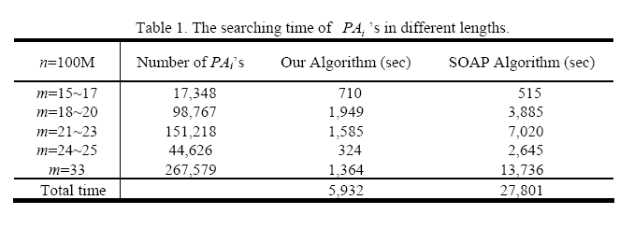
Experiments

Slide 9
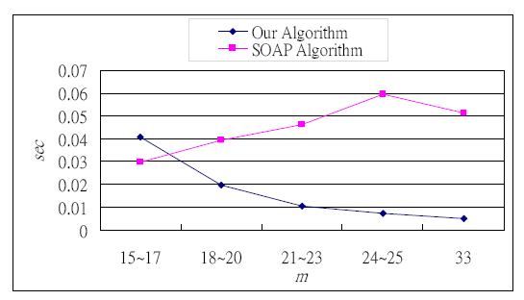
Experiments

